Slide 1

GCSE Home Economics (Food and Nutrition)
Year 10 Options Week

Slide 2
BBC News 06.01.2023
The food and drink industry is the UK's largest manufacturing sector, contributing £28.2bn to the economy annually and employing 400,000 people.
We are a key part of the nation's £110 billion 'farm to fork' food chain.
Our industry is critical to national security and the prosperity of our wider economy

Slide 3

Food around the UK

Slide 4
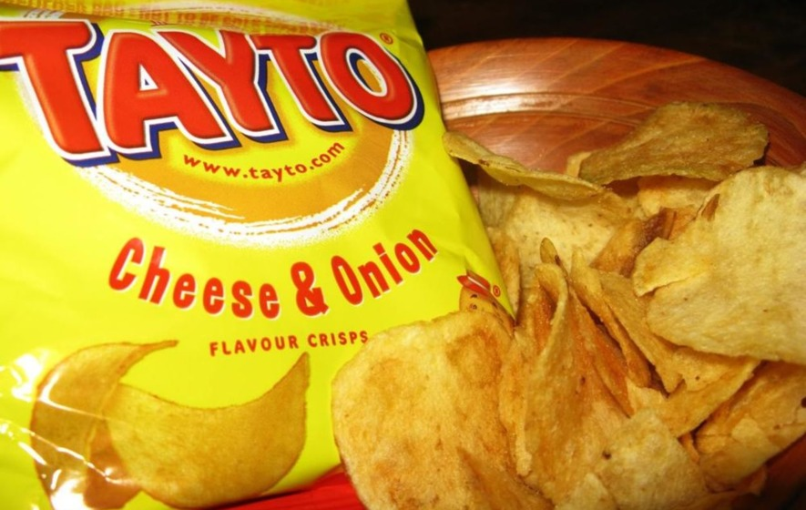
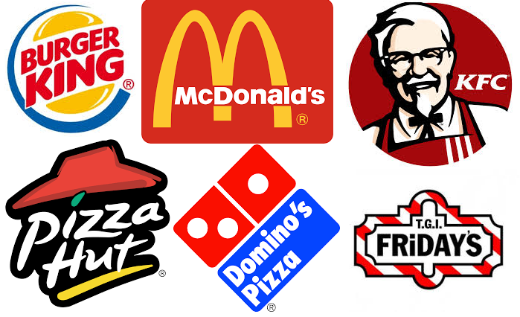

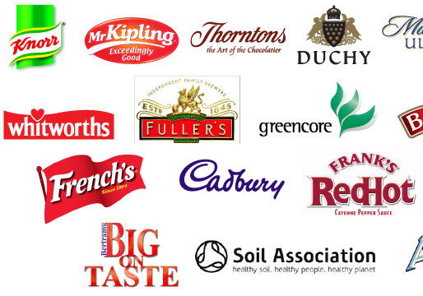

Slide 5

What the course involves?
Home Economics is a two year course which is made up of two different modules.
Component1 Exam(50%)
Component 2 Controlled Assessment (Practical) (50%)

Slide 6
The Course Content
Component 1: Food and Nutrition | 2 hour Exam Completed in Year 12 120 Marks The written paper includes multiple-choice, short and structured questions, and questions requiring extended writing. | 50%

Slide 7
The Course Content
Component 2: Practical Food and Nutrition | Controlled assessment 120 marks Students complete one task that involves the following: Part A: Research and Viewpoints; Part B: Justification of Choice; Part C: Planning; Part D: Practical Activity; and Part E: Evaluation. Students present the written report on the task in the required format. Teachers mark the task, and CCEA moderate the results. | 50%

Slide 8
Why choose it?
Variety of topics covered
Life relevant
Links closely with PE, Business Studies and Biology – Loughry College offer Nutrition and Business Degrees
Learn different skills
Close links with industry – Cunningham’s Kilkeel, DeliLites, LMC
Everyone needs to eat!
Practical skills developed

Slide 9
Topics covered
Nutrition for health
Diet related illnesses
Healthy eating
Legislation
Consumer topics
Credit and debt
How to save money
Practical Skill’s
Energy Balance – how to achieve a healthy weight
Sports nutrition – sports drinks and hydration
Exercise – types of exercise for different individuals
Lots more……….

Slide 10
What Do We Do?
Runs alongside Occupational Studie
2 double classes and 1 singe class a week
Cook almost every double class (Highly Practical)
Single class will be for theory work
Develop your cookery skills
Cooking Demos – LMC, Cake decorating Etc.

Slide 11
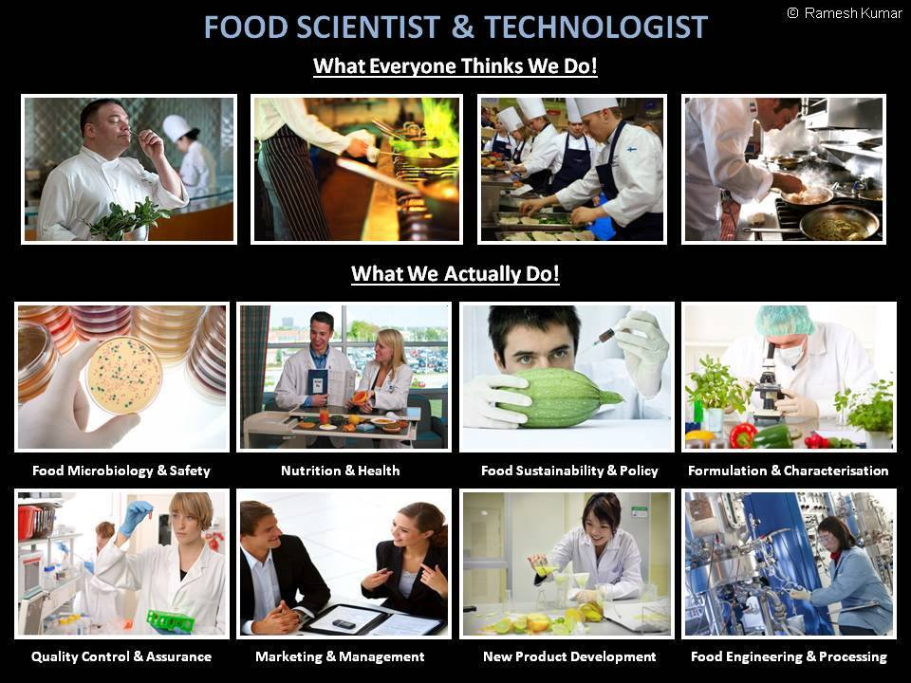

Slide 12


Slide 13
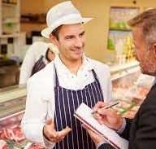
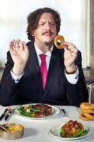
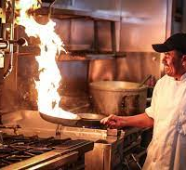

Careers
Baker
Food Producer
Street Vendor
Cake Decorator
Food Taster
Environmental Health Officer
Chef
Food Photographer
Food Critic
Food Technologist
Sports Nutritionist
Food Biologist
Production manager
Marketing manager
Street Vendor
Food Teacher
Home Economist
Food Blogger
Cookbook Author
Candy Maker
Butcher
Food Stylist
Cake Decorator
Dietician
Product control manager
Food Taster

Slide 14
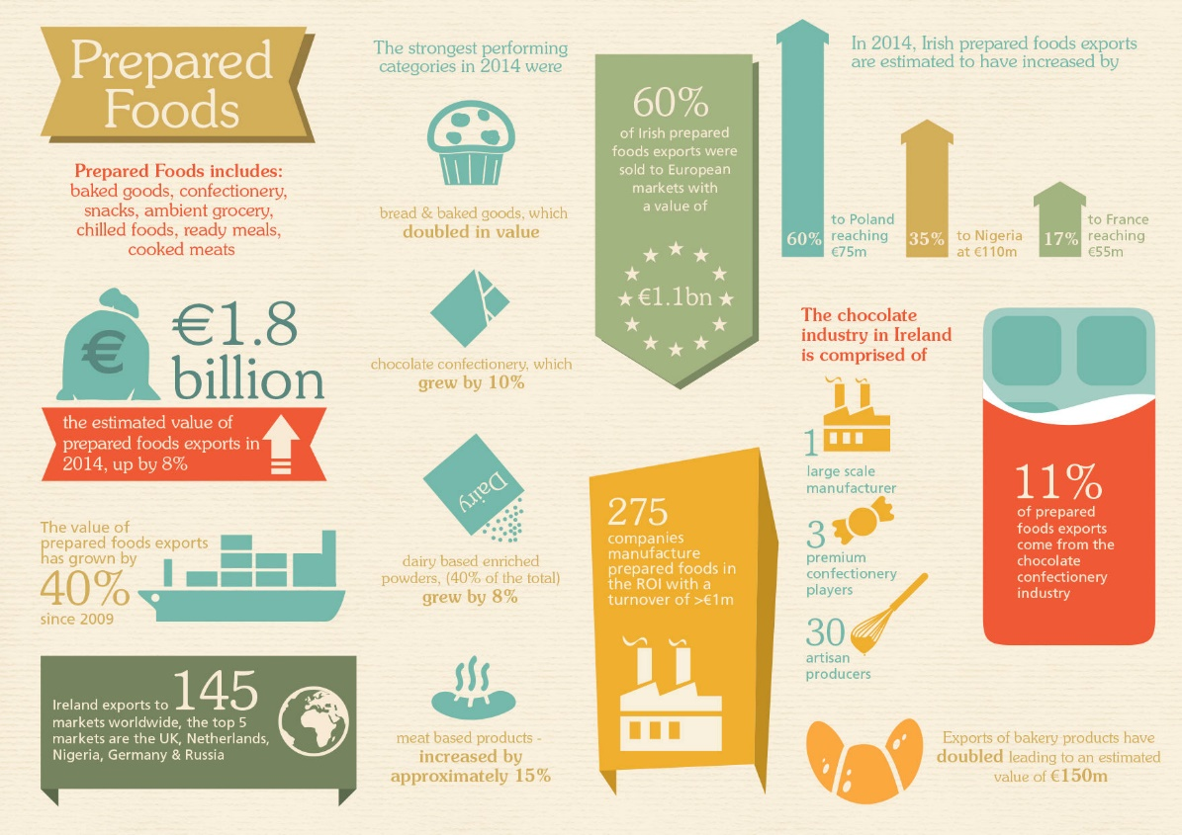

Slide 15
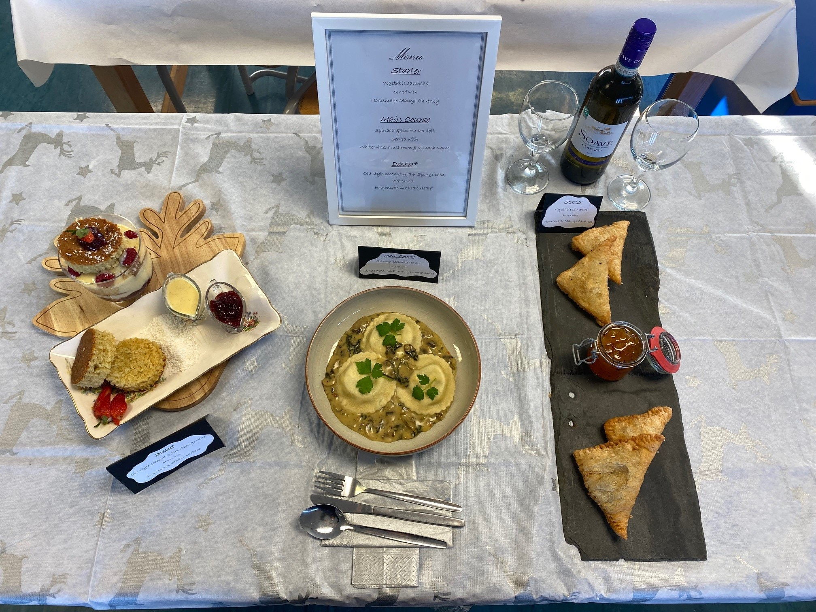
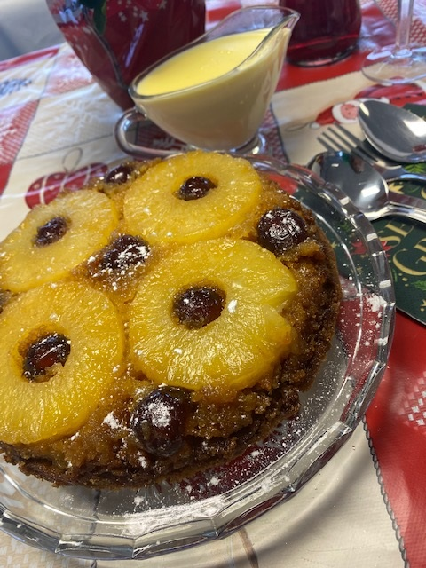
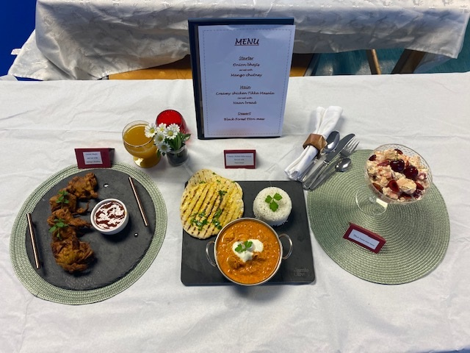
2023 Practical’s

Slide 16
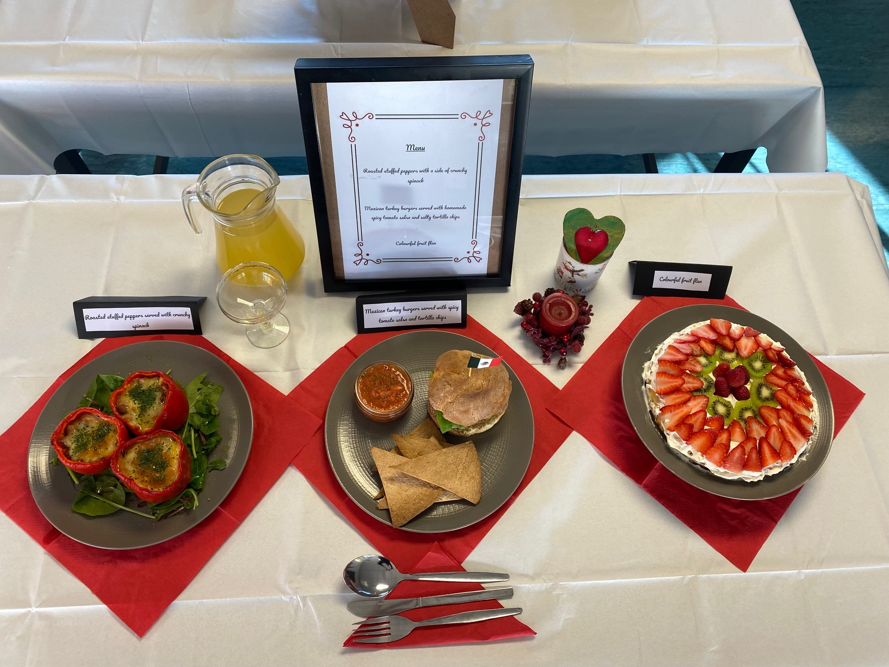
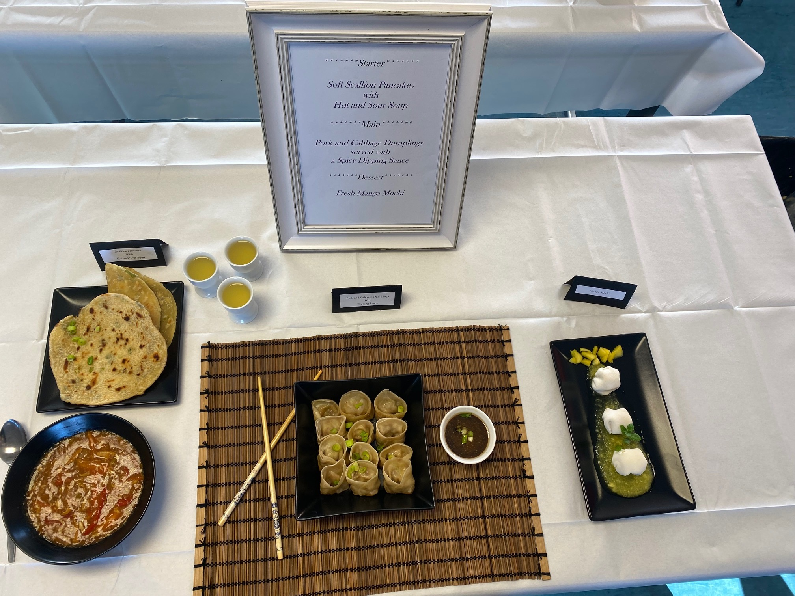
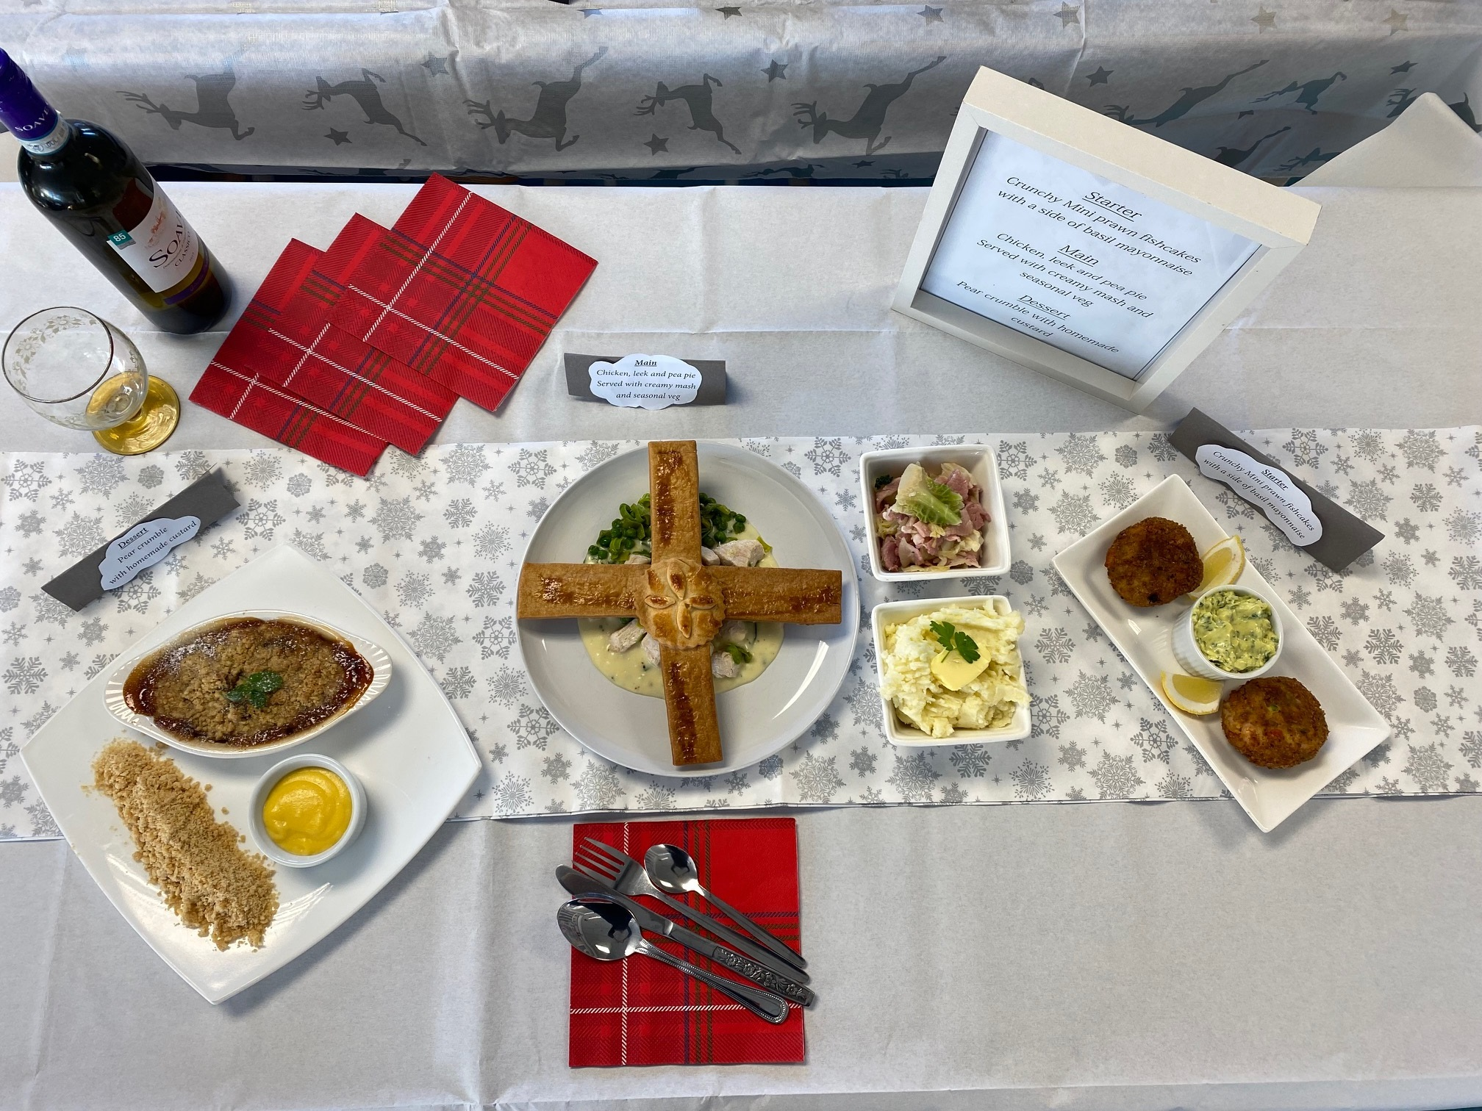
2023 Practical’s

Slide 17
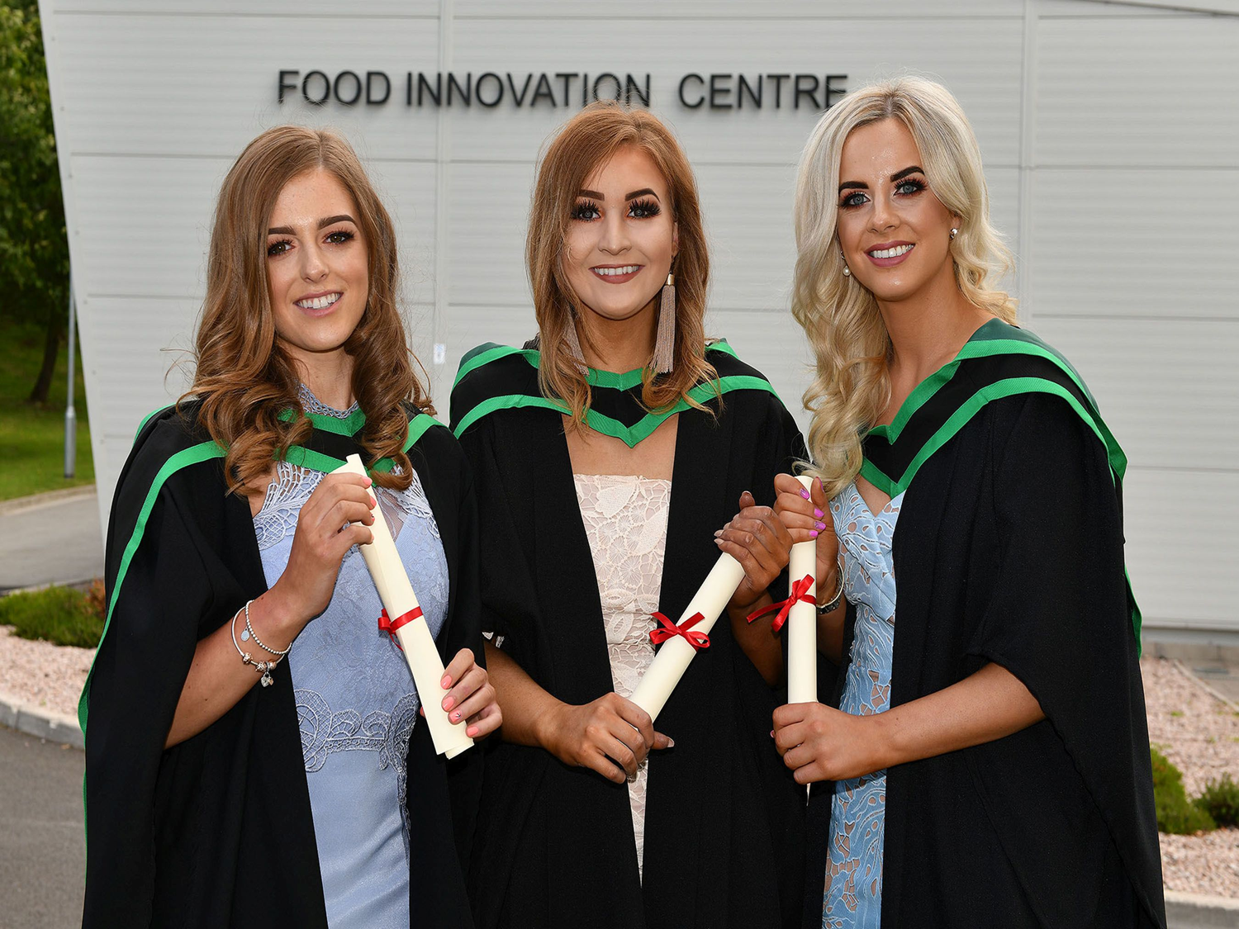

Past A Level students
Law at Queens
Teaching at St Mary’s
Nursing at Queens
Food Nutrition and Design Loughry
Food Business Management Loughry
Criminology in Liverpool
Environmental Health Office x 6
Dietetics
Sports Nutrition/Personal Trainor
Food Product Development Officer

Slide 18


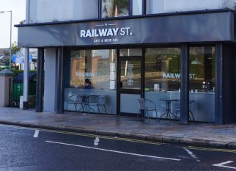

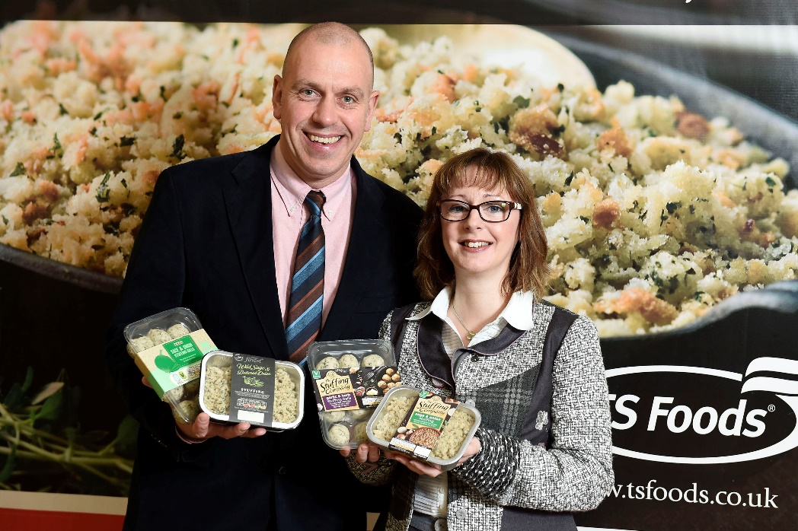

Slide 19
You have to think about the future….
Remember people will always need to eat, this will never change! Therefore the food & drink industry will always remain one of the most profitable and employable sectors in the worldwide market with endless opportunities!

